Slide 1
Introduction to
PythonAnywhere / Flask - Website Creation
Use a PythonAnywhere account.
Create a Flask web-site.
Appendix. Flask web-site created on your laptop.
Presentation is a series of screen shots.
Some files in the presentation (E.g. 404.html & style.css) are copied from the flask examples on github...
https://github.com/pallets/flask-website/tree/master/flask_website
HamPUG - Introducing Python presentations.
10 Apr 2017.
Ian Stewart.

Slide 2
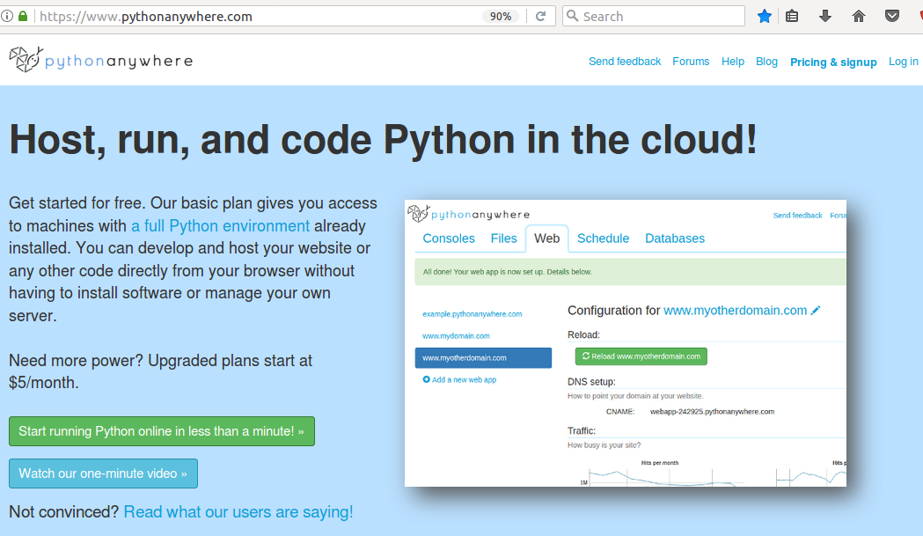
PythonAnywhere link
Create a free account
PythonAnywhere https://www.pythonanywhere.com

Slide 3
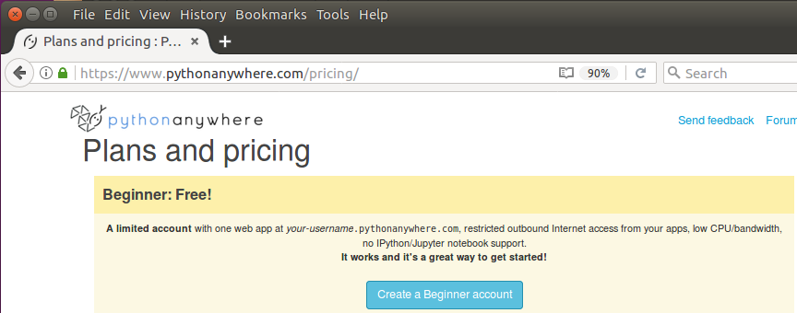
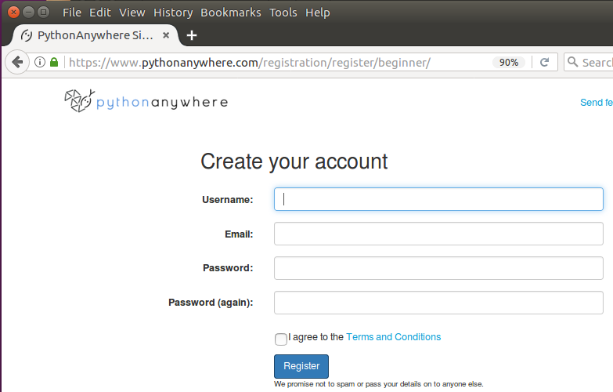
PythonAnywhere link
PythonAnywhere https://www.pythonanywhere.com
Create a free account

Slide 4
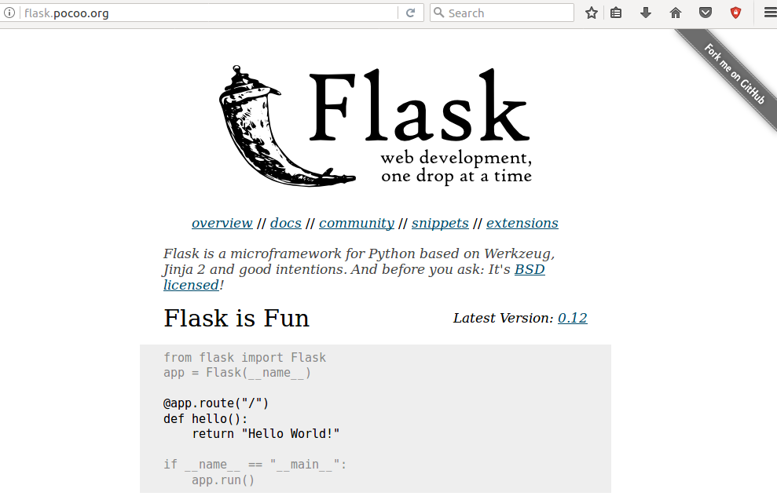
Flask link
Flask http://flask.pocoo.org/

Slide 5
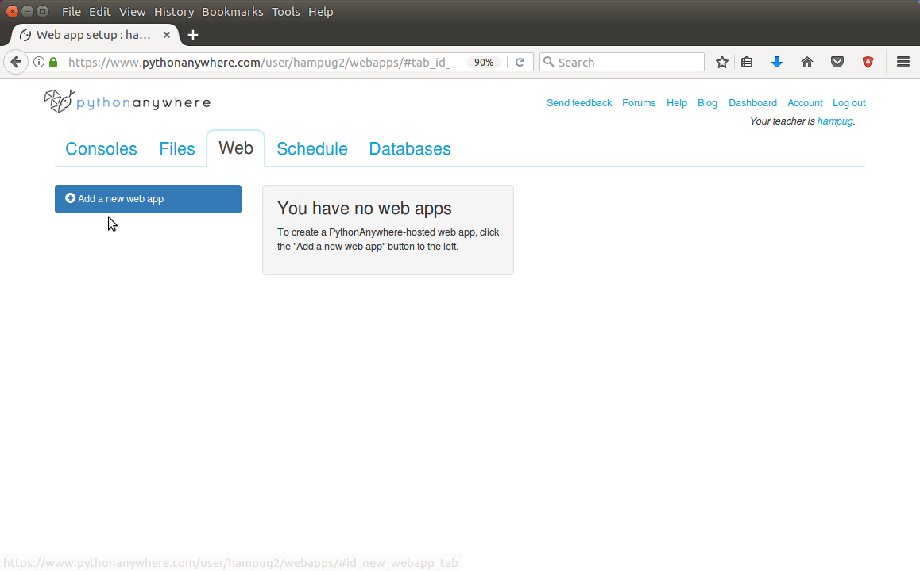
Log into pythonanywhere account.
Select Web and click on “Add new web app”
For this Flask demonstration we only use Files and Web

Slide 6
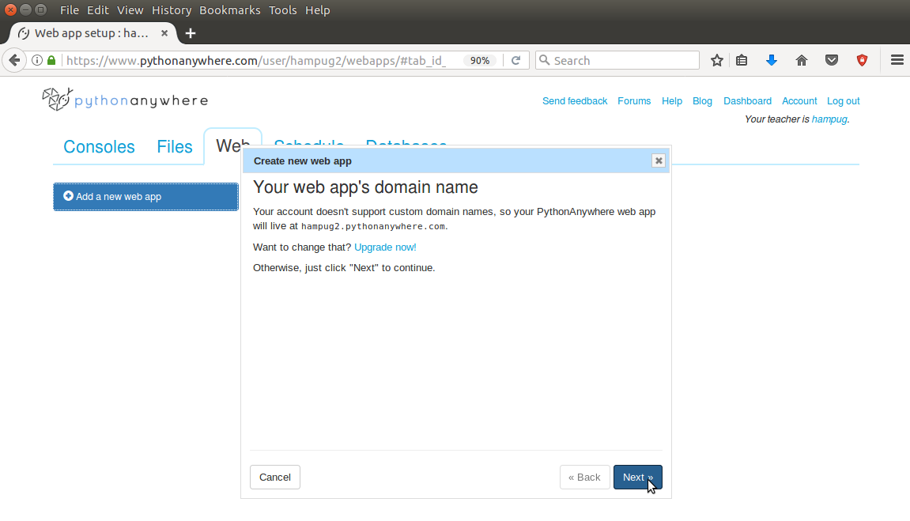
Step 1 in adding new web application...

Slide 7
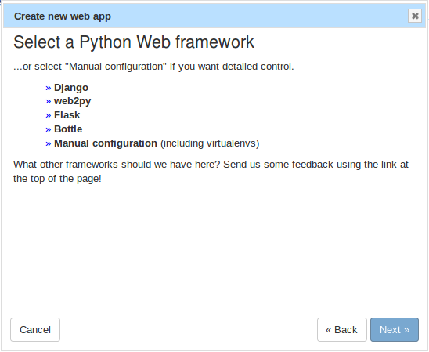
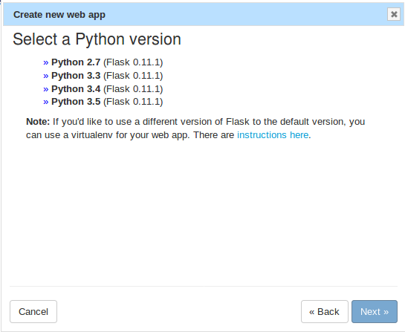
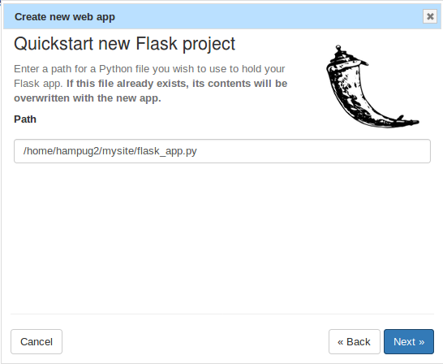
Steps 2, 3 and 4 in adding Flask web application...
In hindsight a better Flask project path and python file...
/home/hampug2/flask_demo/__init.py__
See: https://github.com/pallets/flask-website/tree/master/flask_website

Slide 8
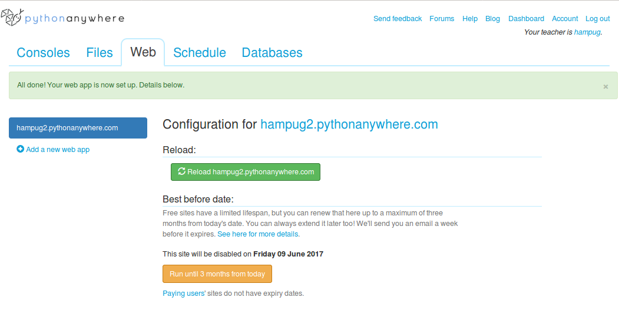
Done. Reload...

Slide 9
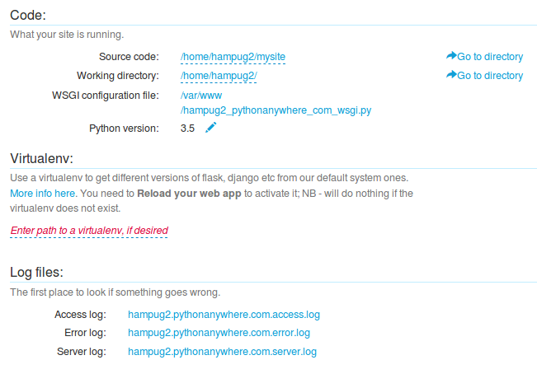
Done. Reload plus Information...

Slide 10
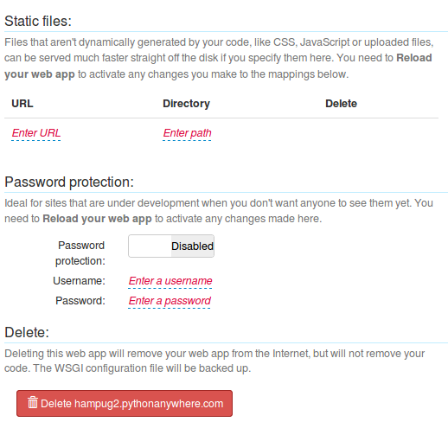
Done. Reload plus Information...

Slide 11
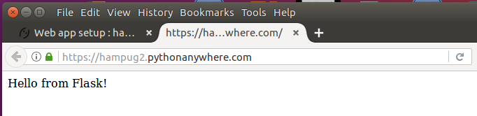
Go to web-site. https://hampug2.pythonanywhere.com

Slide 12
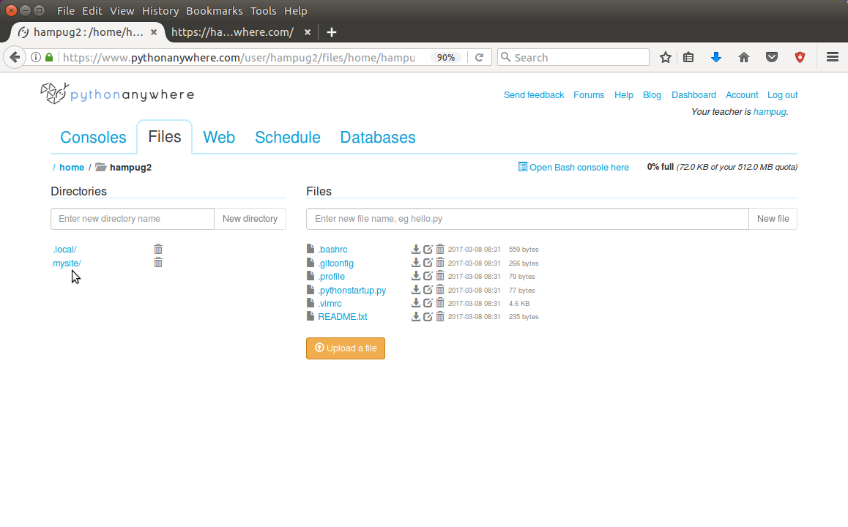
Review the Flask files...

Slide 13
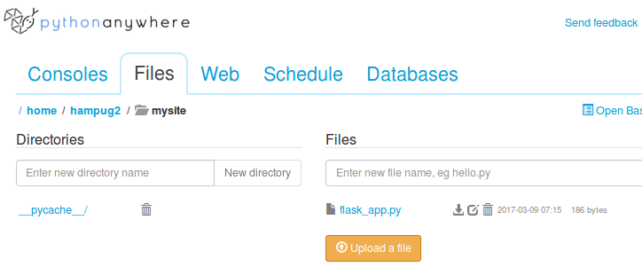
Review the Flask files...

Slide 14
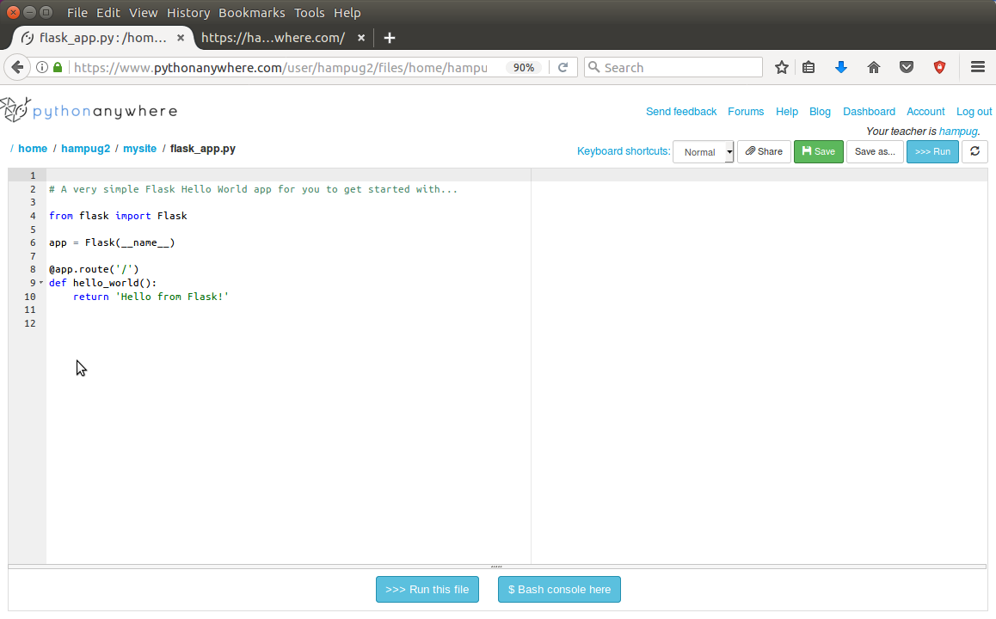
Review the Flask file. flask_app.py...

Slide 15
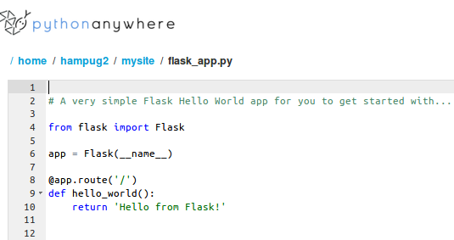
Review the Flask file. flask_app.py...

Slide 16
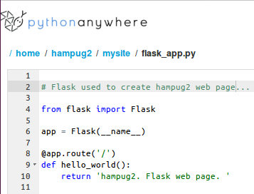
flask_app.py. Enhancements...
Change the wording
...of the html5

Slide 17
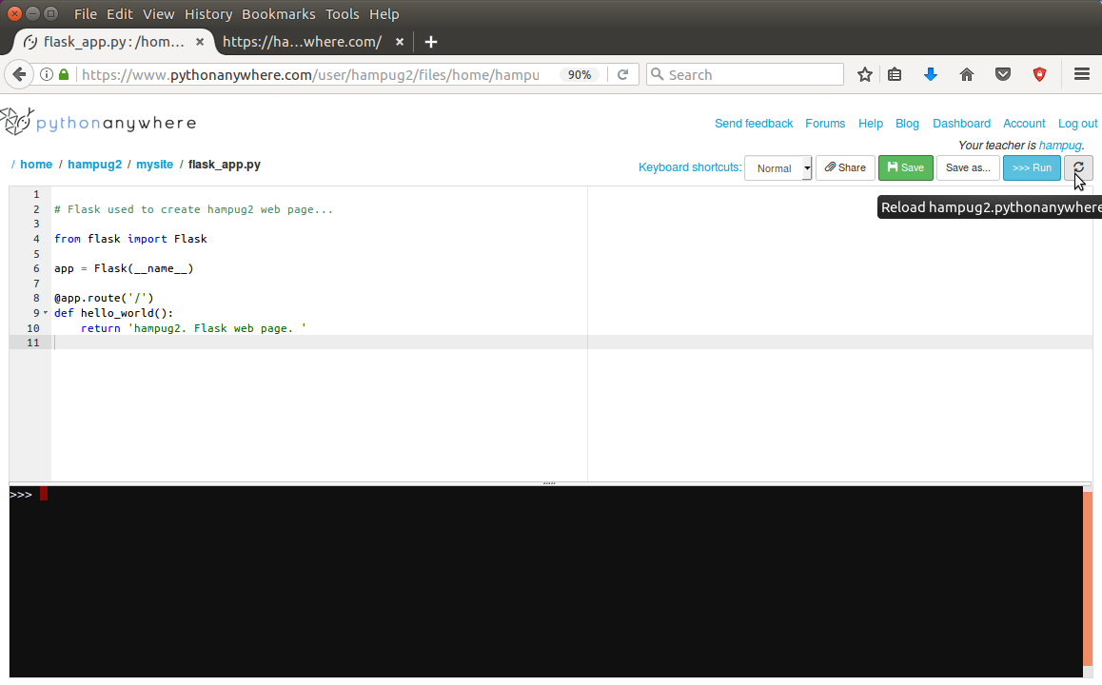
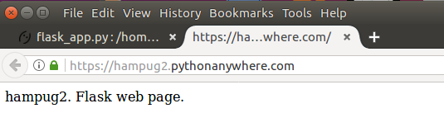
flask_app.py. Enhancements...
Changed wording
Refresh to take effect
New wording

Slide 18
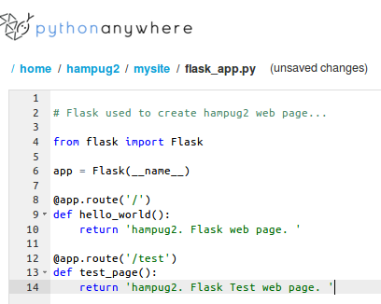
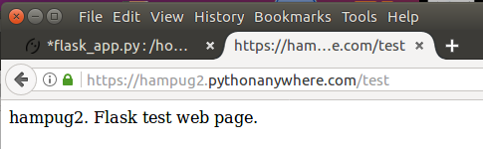
flask_app.py. Enhancements...
Original web page
Add a new web page
New web page at:
/test/

Slide 19
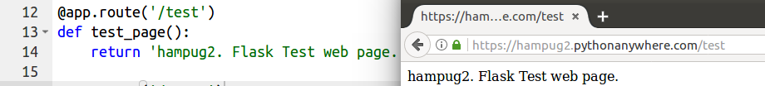
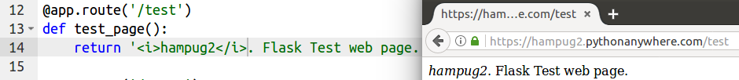
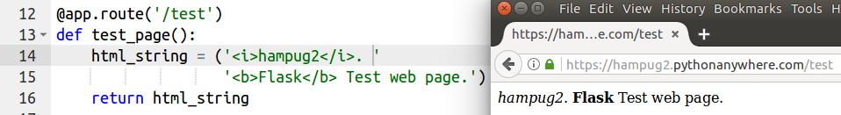
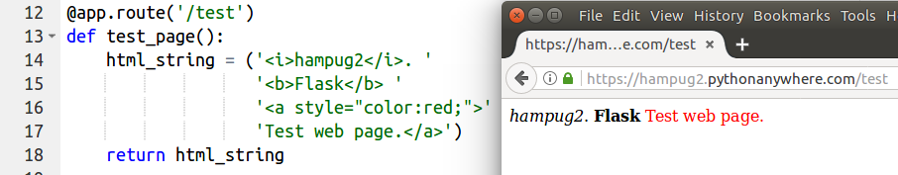
flask_app.py. Enhancements. Does it really parse html?...
Italics <i>
bold <b>
css style

Slide 20
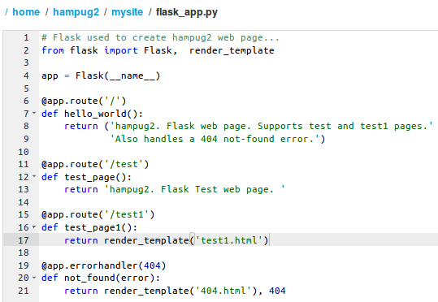
flask_app.py. Enhancements. Use render_template() for test1 and the 404 error handler...
Add test1
Which will display the test1.html file
Add 404 error handler

Slide 21
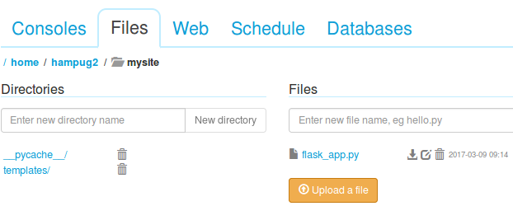
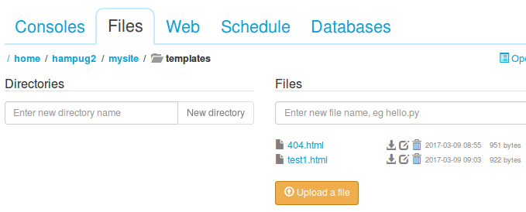
Enhancements. Add /templates/ html files...
Add templates folder
Add test1.html and
404.html files

Slide 22
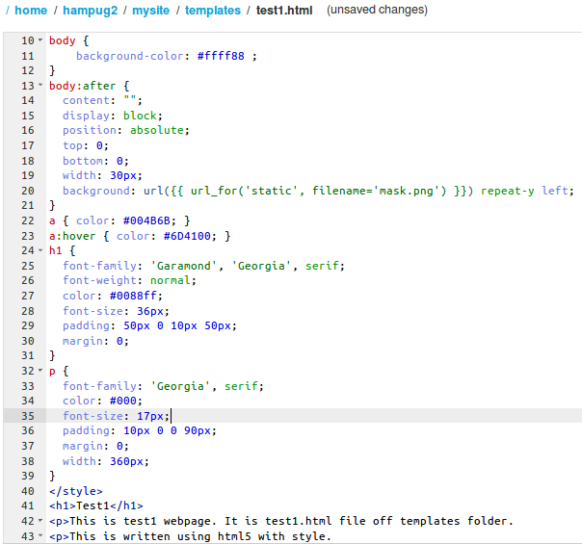
Enhancements. Add test1.html...
In-file cascade style sheets (css) using <style> ... </style>
Set the background colour to yellow (rgb hex ff ff 88)
<h1> heading text colour to be cyan
Heading text <h1> ... </h1>
Main body of text
<p> ... </p>

Slide 23
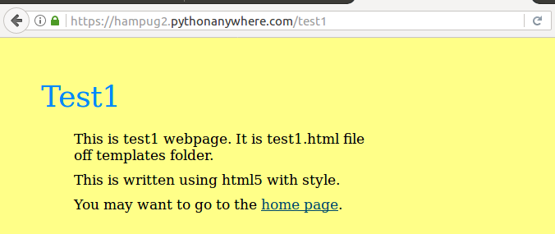
Display /test1...
/test1
<h1> heading text colour cyan
Set the background colour to yellow (rgb hex ff ff 88)
Heading text <h1> ... </h1>
Main body of text
<p> ... </p>

Slide 24
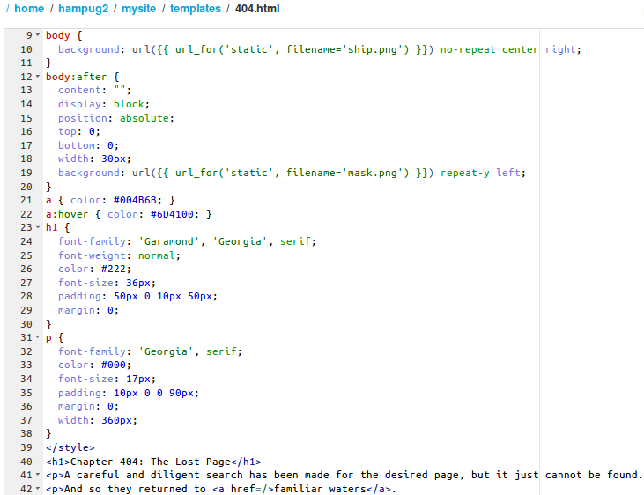
Enhancements. Add 404.html...
In-file cascade style sheets (css) using <style> ... </style>
Heading text <h1> ... </h1>
Main body of text
<p> ... </p>

Slide 25
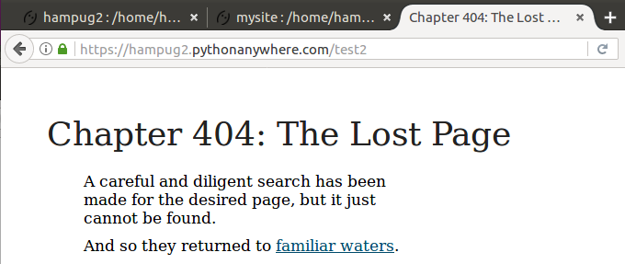
Try to display /test2
/test2 does NOT exist
Heading text <h1> ... </h1>
Main body of text
<p> ... </p>
html to return to home page “/”...
<p>And so they returned to <a href=/>familiar waters</a>

Slide 26
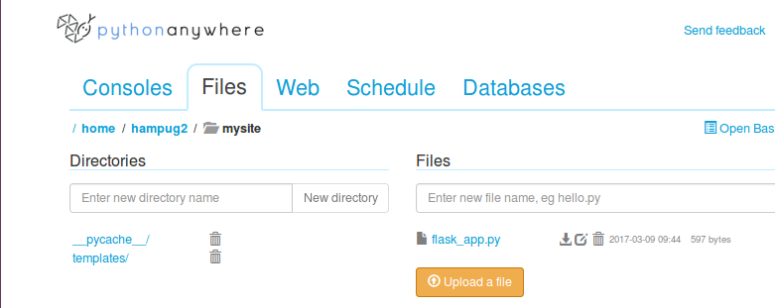
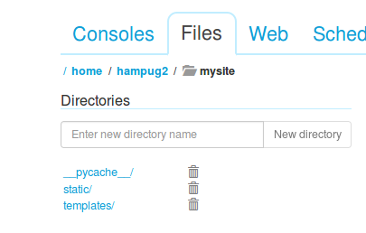
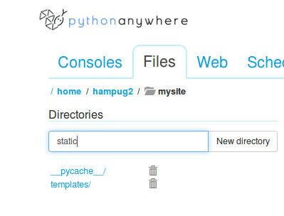
Enter “static” as directory name and click on new directory...
Static directory added

Slide 27
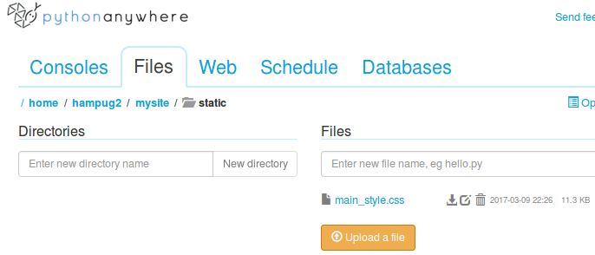
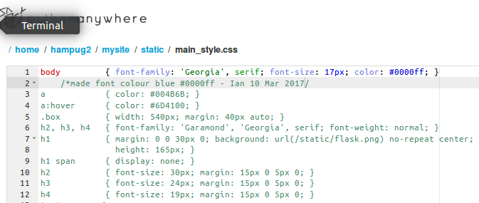
Add main_style.css file in static directory...
Add main_style.css
Add the styles into main_style.css
Text colour is blue

Slide 28
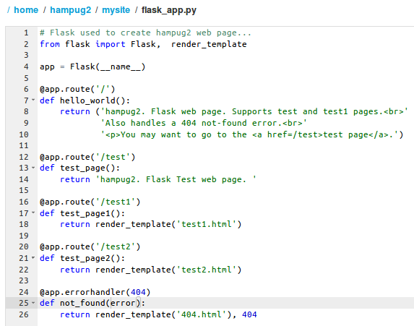
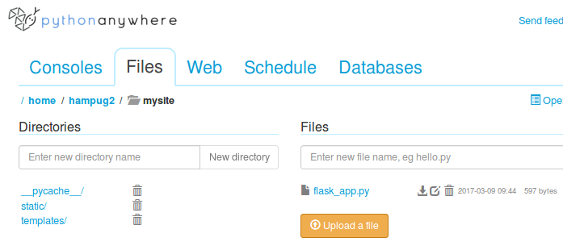
Edit flask_app.py. Add new /test2 web page..
Add /test2 web page

Slide 29
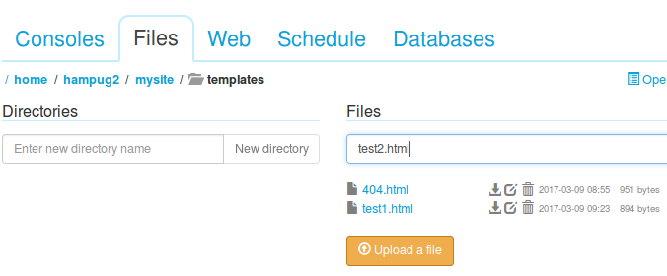
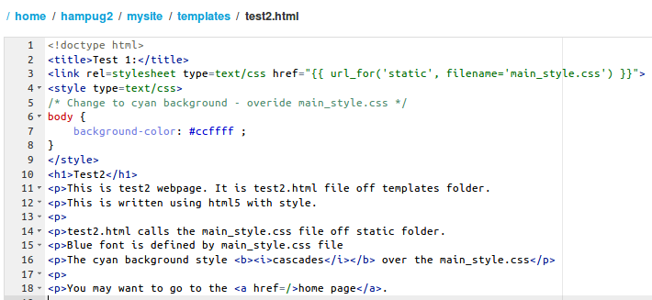
In templates directory add test2.html
Add test2.html file
Include the link to .static/main_style.css
Title should be Test 2
Over-ride main_style.css with in-file <style> to set the background colour to cyan – rgb cc ff ff
Text of the web page. Should be in <body>

Slide 30
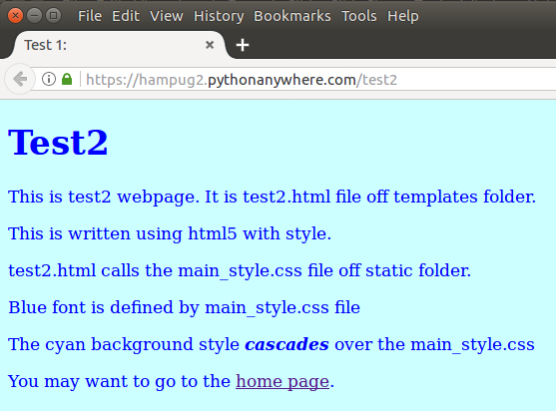
Display test2 web page...

Slide 31
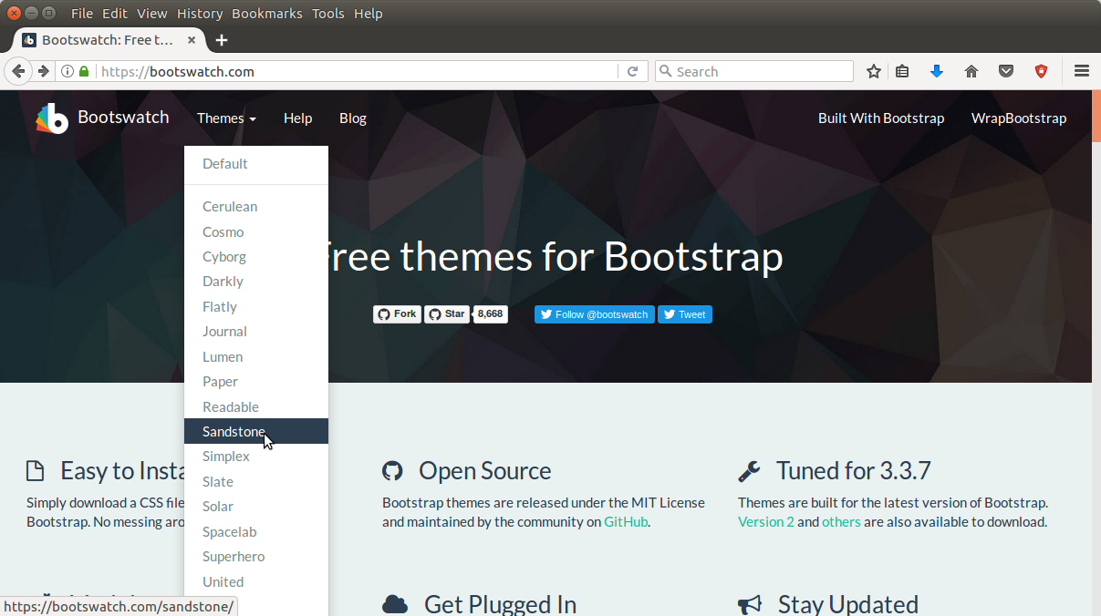
Get a free css file. For example...
Go to: https://bootswatch.com/ ... and pick a theme...
th

Slide 32
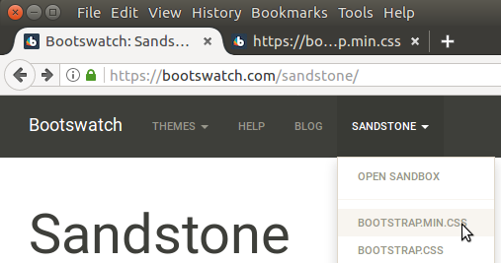
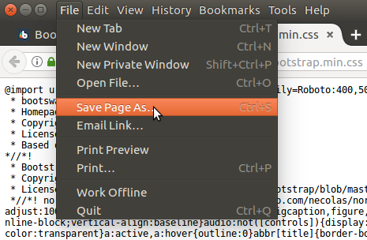
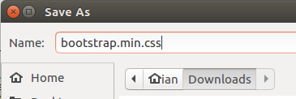
Open and then save/download...
https://bootswatch.com/sandstone/bootstrap.min.css

Slide 33
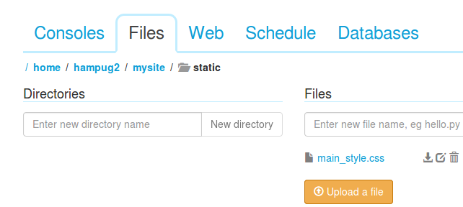
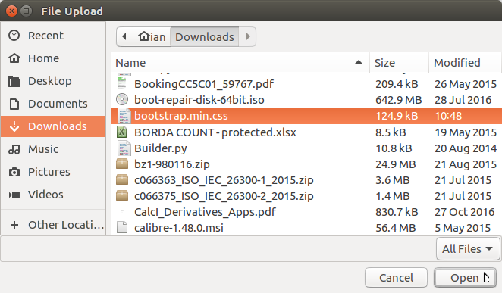
To place css file into static directory, click “Upload a file”...

Slide 34
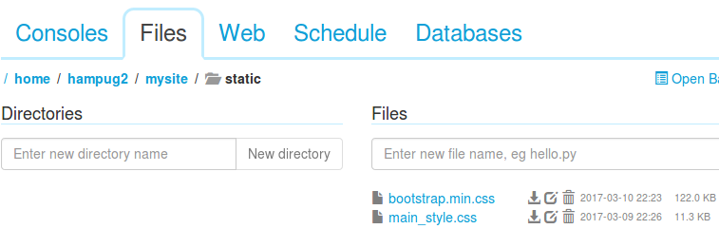

bootstrap.min.css is now in /static/ folder ...
Go to /templates/ and edit test2.html webpage...

Slide 35


Edit test2.html.
Change main_style.css to bootstrap.min.css ...

Slide 36

Edit test2.html. Background, in-file <style> in-line style, etc...

Slide 37

Difference in web-page when using bootstrap.min.css...
Before. No bootstrap.min.css
After. With bootstrap.min.css

Slide 38
End of introduction to using
pythonanywhere.com account and Flask to create a
web site.
Flask Documentation:
http://flask.pocoo.org/docs/0.12/
http://wsgi.readthedocs.io/en/latest/what.html
Checkout the web-pages at:
https://hampug2.pythonanywhere.com/
...however they will be deleted in the future.
Appendix:
Installing flask locally on a ubuntu laptop.
Using markdown files.
Webpage online.

Slide 39
Appendix – Install of Flask for python3 on ubuntu 16.04.
$ sudo apt-get install python3-flask
The following additional packages will be installed:
python3-itsdangerous python3-openssl python3-pyinotify python3-werkzeug
Suggested packages:
python-flask-doc python-openssl-doc python3-openssl-dbg python-pyinotify-doc
python-werkzeug-doc
The following NEW packages will be installed:
python3-flask python3-itsdangerous python3-openssl python3-pyinotify
python3-werkzeug
0 upgraded, 5 newly installed, 0 to remove and 0 not upgraded.
Need to get 334 kB of archives.
After this operation, 1,768 kB of additional disk space will be used.

Slide 40
Appendix – import flask and dir(flask)
$ python3
Python 3.5.2 (default, Nov 17 2016, 17:05:23)
[GCC 5.4.0 20160609] on linux
Type "help", "copyright", "credits" or "license" for more information.
>>> import flask
>>> dir()
['__builtins__', '__doc__', '__loader__', '__name__', '__package__', '__spec__', 'flask']
>>> dir(flask)
['Blueprint', 'Config', 'Flask', 'Markup', 'Module', 'Request', 'Response', 'Session', '__builtins__', '__cached__', '__doc__', '__file__', '__loader__', '__name__', '__package__', '__path__', '__spec__', '__version__', '_app_ctx_stack', '_compat', '_request_ctx_stack', 'abort', 'after_this_request', 'app', 'appcontext_popped', 'appcontext_pushed', 'appcontext_tearing_down', 'blueprints', 'config', 'copy_current_request_context', 'ctx', 'current_app', 'debughelpers', 'escape', 'flash', 'g', 'get_flashed_messages', 'get_template_attribute', 'globals', 'got_request_exception', 'has_app_context', 'has_request_context', 'helpers', 'json', 'json_available', 'jsonify', 'make_response', 'message_flashed', 'module', 'redirect', 'render_template', 'render_template_string', 'request', 'request_finished', 'request_started', 'request_tearing_down', 'safe_join', 'send_file', 'send_from_directory', 'session', 'sessions', 'signals', 'signals_available', 'stream_with_context', 'template_rendered', 'templating', 'url_for', 'wrappers']
>>>

Slide 41
Appendix – import flask and dir(flask)
>>> dir(flask.Flask)
['__call__', '__class__', '__delattr__', '__dict__', '__dir__', '__doc__', '__eq__', '__format__', '__ge__', '__getattribute__', '__gt__', '__hash__', '__init__', '__le__', '__lt__', '__module__', '__ne__', '__new__', '__reduce__', '__reduce_ex__', '__repr__', '__setattr__', '__sizeof__', '__str__', '__subclasshook__', '__weakref__', '_register_error_handler', 'add_template_filter', 'add_template_global', 'add_template_test', 'add_url_rule', 'after_request', 'app_context', 'app_ctx_globals_class', 'auto_find_instance_path', 'before_first_request', 'before_request', 'context_processor', 'create_global_jinja_loader', 'create_jinja_environment', 'create_url_adapter', 'debug', 'debug_log_format', 'default_config', 'dispatch_request', 'do_teardown_appcontext', 'do_teardown_request', 'enable_modules', 'endpoint', 'error_handlers', 'errorhandler', 'full_dispatch_request', 'get_send_file_max_age', 'got_first_request', 'handle_exception', 'handle_http_exception', 'handle_url_build_error', 'handle_user_exception', 'has_static_folder', 'init_jinja_globals', 'inject_url_defaults', 'jinja_env', 'jinja_loader', 'jinja_options', 'json_decoder', 'json_encoder', 'log_exception', 'logger', 'logger_name', 'make_config', 'make_default_options_response', 'make_null_session', 'make_response', 'modules', 'name', 'open_instance_resource', 'open_resource', 'open_session', 'permanent_session_lifetime', 'preprocess_request', 'preserve_context_on_exception', 'process_response', 'propagate_exceptions', 'raise_routing_exception', 'register_blueprint', 'register_error_handler', 'register_module', 'request_class', 'request_context', 'request_globals_class', 'response_class', 'route', 'run', 'save_session', 'secret_key', 'select_jinja_autoescape', 'send_static_file', 'session_cookie_name', 'session_interface', 'should_ignore_error', 'static_folder', 'static_url_path', 'teardown_appcontext', 'teardown_request', 'template_filter', 'template_global', 'template_test', 'test_client', 'test_client_class', 'test_request_context', 'testing', 'trap_http_exception', 'try_trigger_before_first_request_functions', 'update_template_context', 'url_defaults', 'url_rule_class', 'url_value_preprocessor', 'use_x_sendfile', 'wsgi_app']
>>>

Slide 42

Appendix – flask – local hello world.
$ cat hello.py
from flask import Flask
app = Flask(__name__)
@app.route("/")
def hello():
return "Hello World!"
if __name__ == "__main__":
app.run()
$ python3 hello.py
* Running on http://127.0.0.1:5000/ (Press CTRL+C to quit)

Slide 43


Appendix – flask – local hello world.
from flask import Flask
app = Flask(__name__)
@app.route("/")
def hello():
return ("Hello <b>World!</b><br>"
"Go to: <a href=/demo1>demo1.</a>")
@app.route("/demo1")
def demo1():
html_string = ("<b>Hello World!</b> from "
"<i>/demo1</i><br>"
"Go <a href=/>home.</a>")
return html_string
if __name__ == "__main__":
app.run()

Slide 44


Appendix – flask – local hello world.
from flask import Flask, render_template
app = Flask(__name__)
@app.route("/")
def hello():
return ("Hello <b>World!</b><br>"
"Go to: <a href=/demo1>demo1.</a>")
@app.route("/demo1")
def demo1():
html_string = ("<b>Hello World!</b> from "
"<i>/demo1</i><br>"
"Go <a href=/>home.</a>")
return html_string
@app.route("/demo2")
def demo2():
return render_template("demo2.html")
@app.errorhandler(404)
def not_found(error):
return render_template('404.html'), 404
if __name__ == "__main__":
app.run()

Slide 45

Appendix – demo2.html.
<!doctype html>
<p>Hello from demo2</p>
Enhance demo2.html.
<!doctype html>
<title>Demo 2</title>
<link rel=stylesheet type=text/css
href="{{ url_for('static', filename='bootstrap.min.css') }}">
<style>body {background-color:#ccccff;}</style>
<h2>Demo 2 Heading</h2>
<p>Hello from demo2</p>
<p>Making use of bootstrap.min.css in static directory</p>

Slide 46

Appendix – 404.html
<!doctype html>
<title>Chapter 404: The Lost Page</title>
<style type=text/css>
body, html {
height: 100%;
margin: 0;
padding: 0;
}
<!-- Other style items deleted>
</style>
<h1>Chapter 404: The Lost Page</h1>
<p>A careful and diligent search has been made for the desired page, but it just cannot be found.
<p>And so they returned to <a href=/>familiar waters</a>.

Slide 47
Appendix – Tree
├── demo1
│ ├── demo1a.py
│ ├── demo1b.py
│ ├── demo1.py
│ ├── __init__.py
│ ├── static
│ │ └── bootstrap.min.css
│ └── templates
│ ├── 404.html
│ └── demo2.html

Slide 48
Appendix – Webpage built with markdown files.
Import markdown
@app.route("/hampug")
def hampug():
# Use the style_loader.html in templates directory
style_string = render_template("style_loader.html")
# Build the html string.
heading = "<h1>HamPUG - Hamilton Python User Group</h1>"
heading = heading + ("<img src='static/background.jpg' "
"width='1000' height='200'>")
heading = heading + "<h2>Welcome to the Hamilton Python User Group</h2>"
# Read markdown files.
md = ""
md = md + open("static/hampug_meetup.md", "r").read()
md = md + open("static/hampug_overview.md", "r").read()
md = md + open("static/hampug_history.md", "r").read()
return style_string + heading + markdown.markdown(md)

Slide 49

Appendix – Webpage built with markdown files.

Slide 50

Appendix – Webpage built with markdown files – on-line.
http://hampug2.pythonanywhere.com/hampug

Slide 51
Appendix
End

